Slide 1
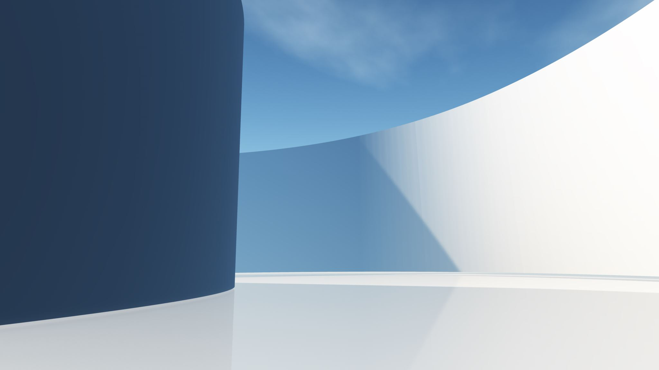
DELE CA1 Part A: Convolutional Neural Network
Name: IVAN TAY YUEN HENG
Class: DAAA/FT/2B/03

Slide 2
Part A Steps
Data preparation
Preprocess features
Check class imbalance
Convert train, validation and test dataset
Rebalance class weight
3) Modelling
37 pixel and 131 pixel
Hyperparameter tuning
4) Model Evaluation
Show accuracy
Classification matrix
Visualize model

Slide 3
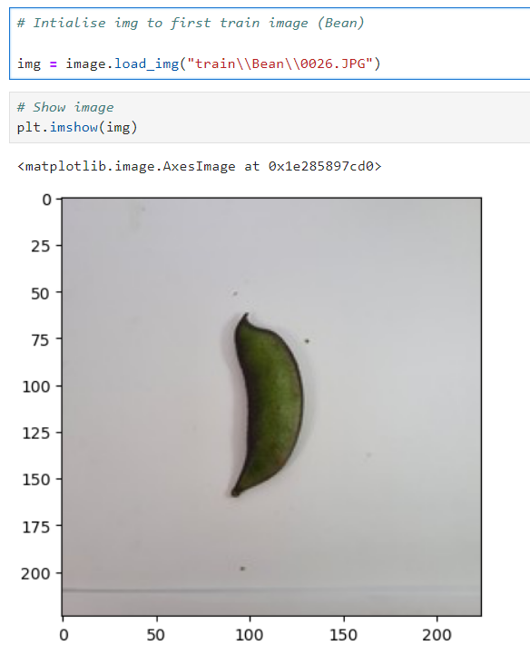
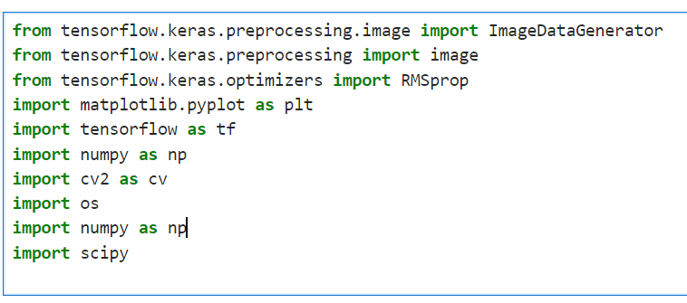
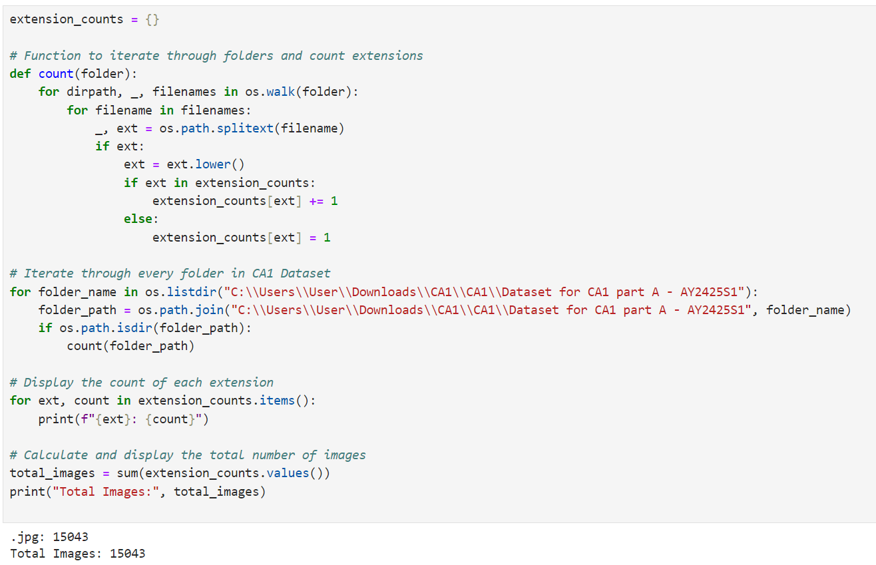

Data preparation
1) Import necessary modules
3) Do an image analysis to check the image in a folder. An example of an image is shown as a graph.
4) Show shape of the current images. This image contain 224 pixel by 224 pixel with 3 channel. We want to convert them into 37 by 37 pixel and 131 pixel by 131 pixel, both with 1 channel. (37, 37, 1) and (131, 131, 1)
2) Do a file analysis to check what file extension each image have. Since, all file image are in jpg, we do not need to worry about file extension

Slide 4
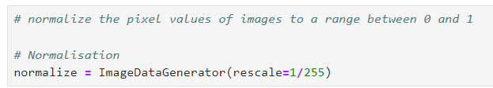
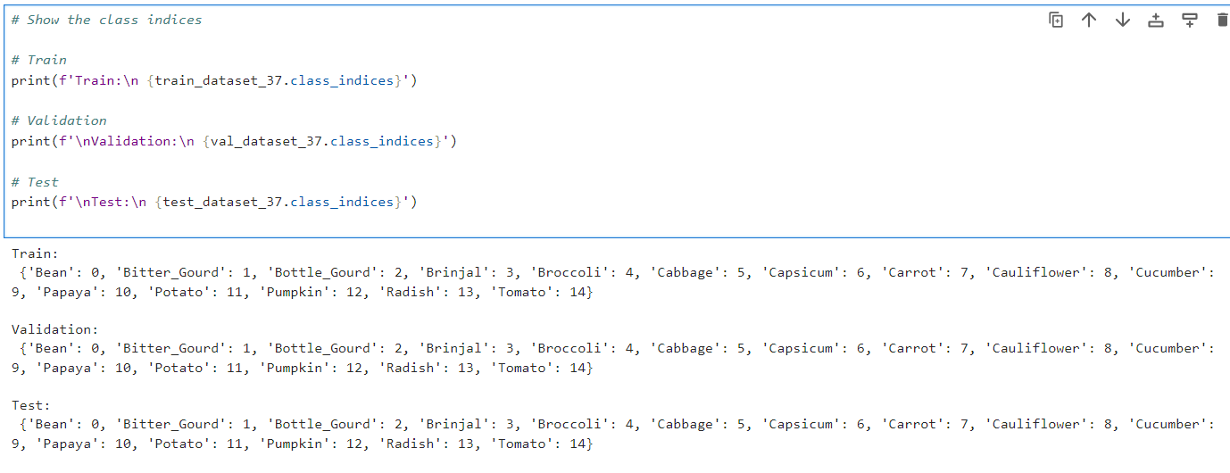
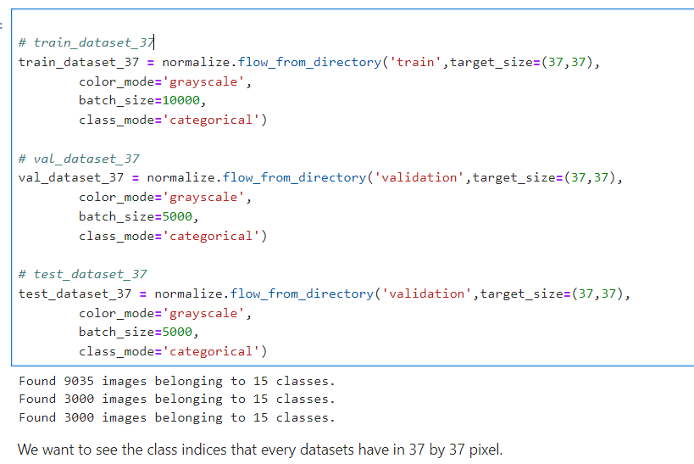
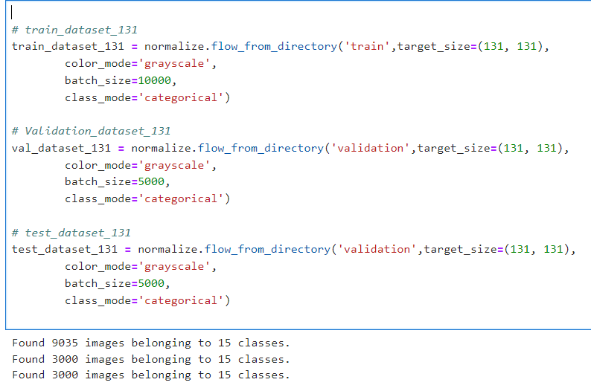
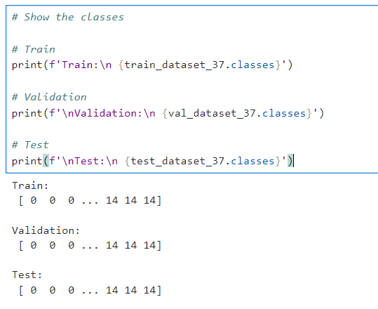
Preprocessing features
1) We are going to use ImageDataGenerator to normalize the pixel values of images to a range between 0 and 1.
2) We normalize one dataset and convert images into 37 by 37 pixel. Then, We normalize second dataset and convert images into 131 by 131 pixel. Both dataset are grayscale (1 channel)
3) Show the class indices for both 37 by 37 pixel and 131 by 131 pixel. Then, show both classes which is range 0 to 14.

Slide 5
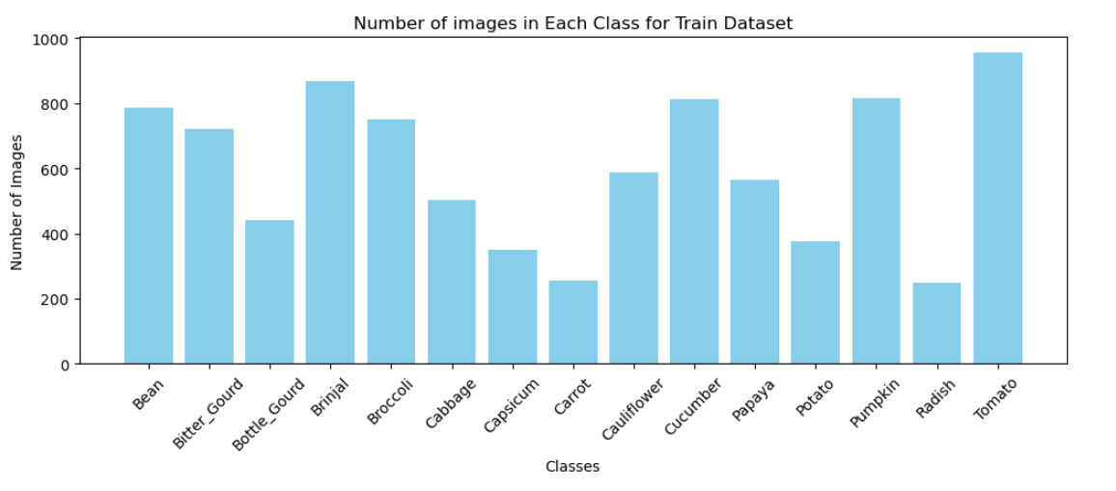
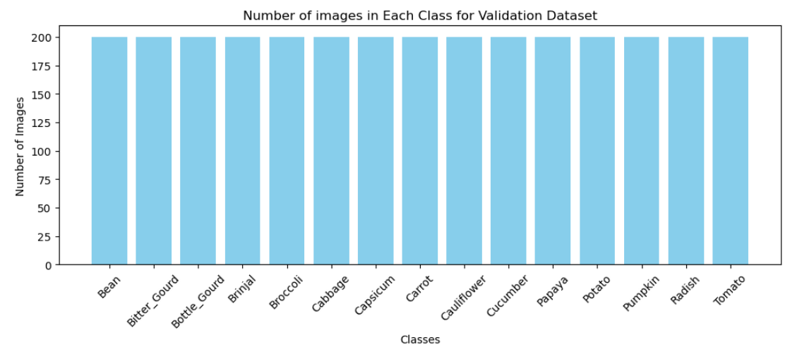
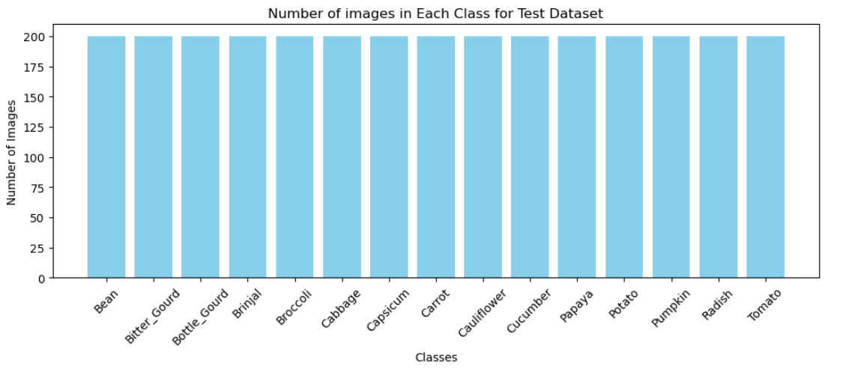
Check for class imbalance
There is class imbalance for train dataset. However, there is no class imbalance for validation and test dataset. We will deal with that after we split the train, validation, test.

Slide 6
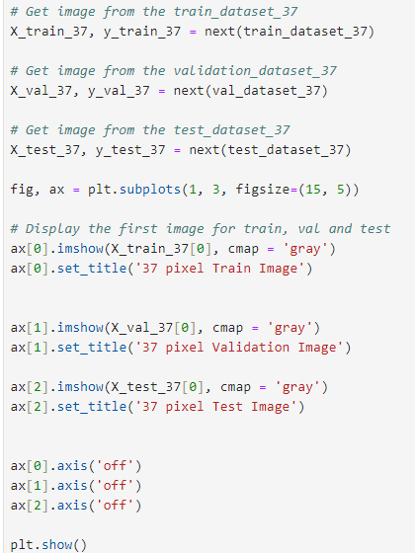
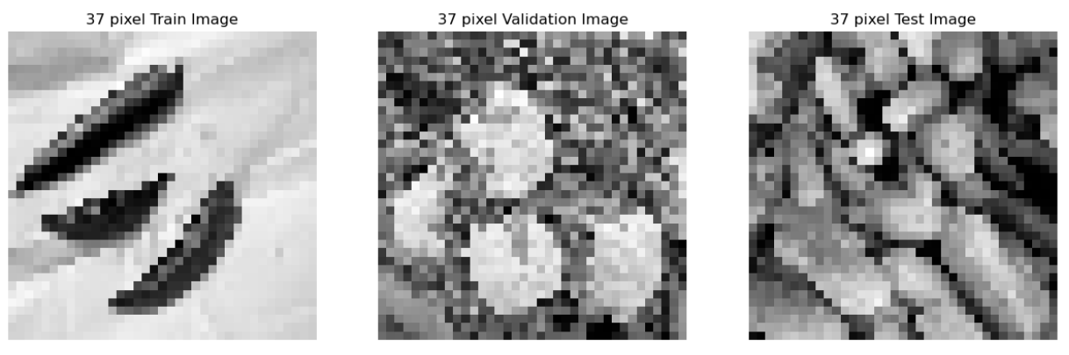
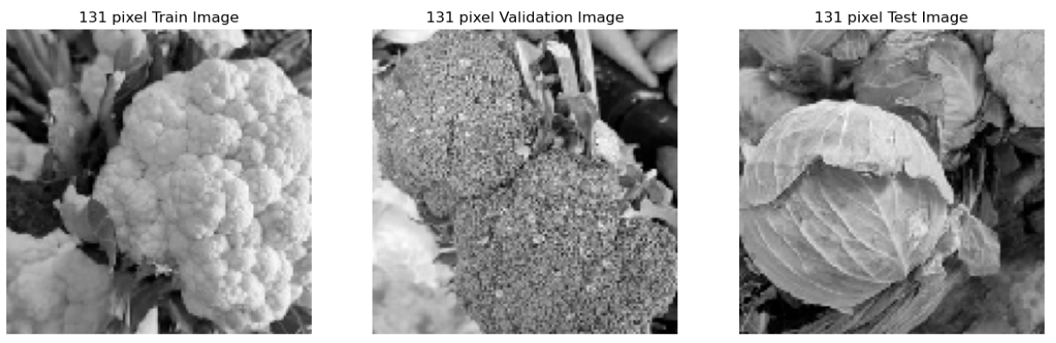
Convert train, validation and test dataset
Split into X_train, y_train, X_val, y_val, X_test, y_test for both 37 and 131 pixel. Then display out.

Slide 7
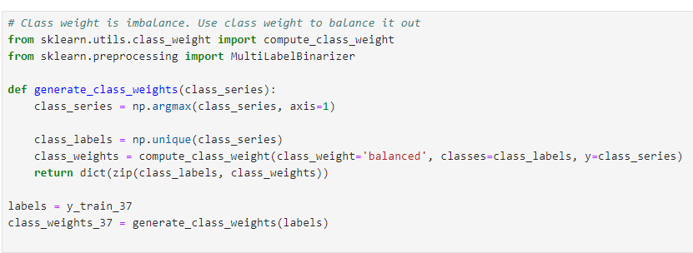
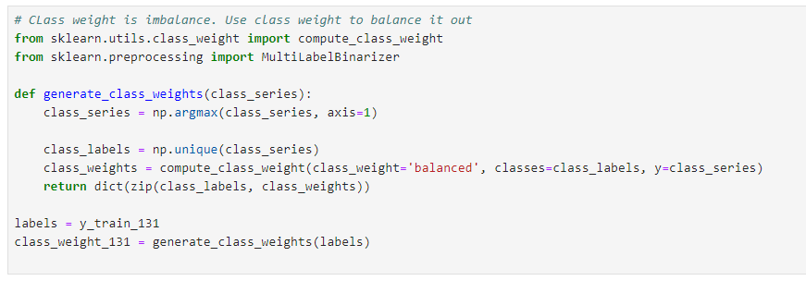
Rebalance class weights
Create class_weights_37 and class_weights_131 for both models later to rebalance class weight to improve accuracy.

Slide 8
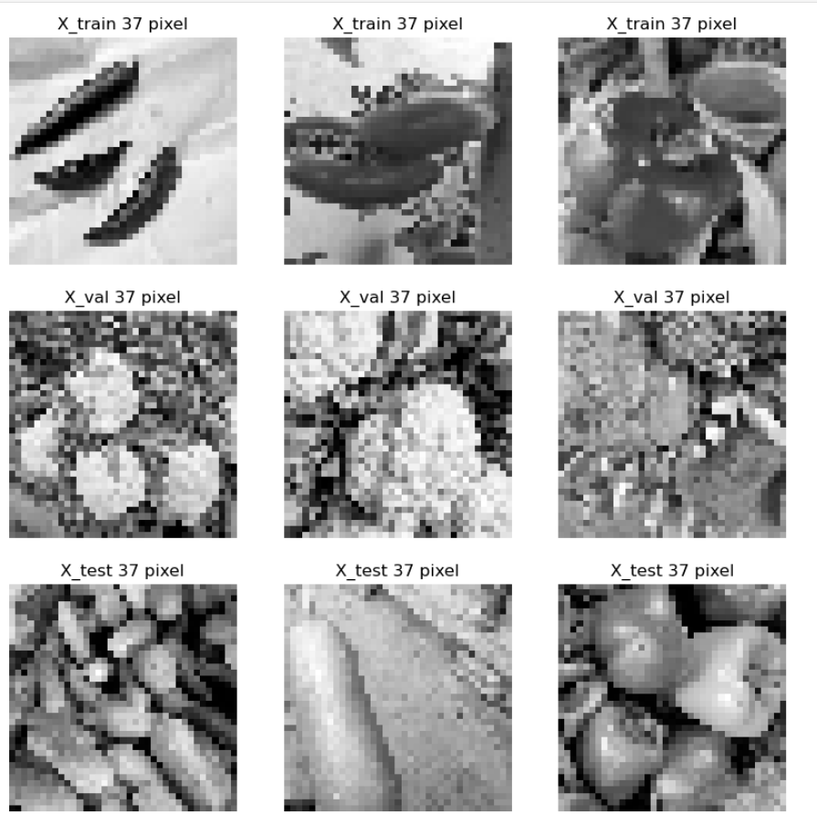
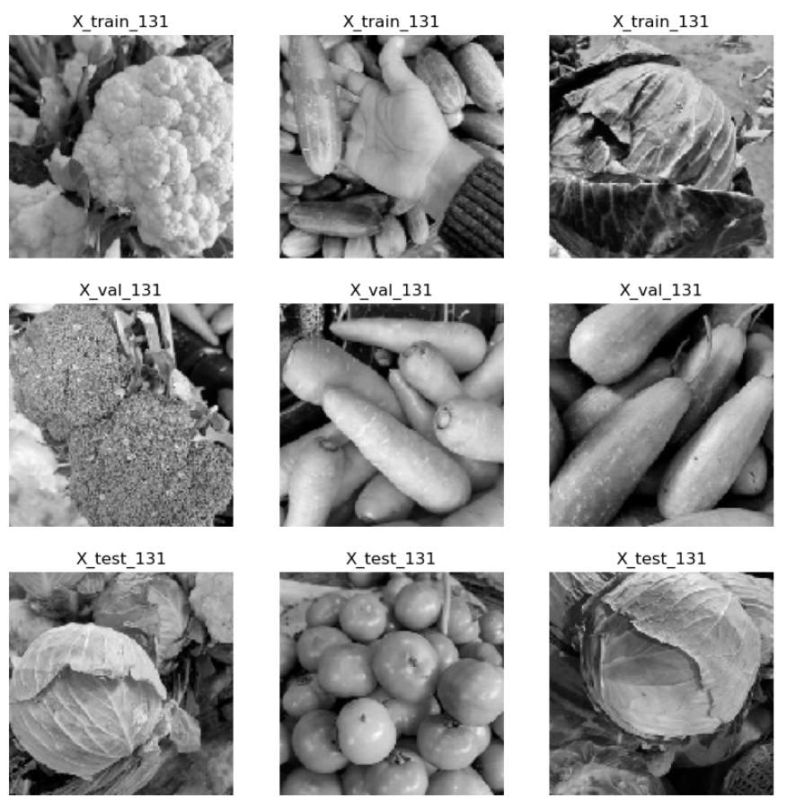
Show example of 37 pixel and 131 pixel
37 pixel for X_train, X_val and X_test
131 pixel for X_train, X_val and X_test

Slide 9
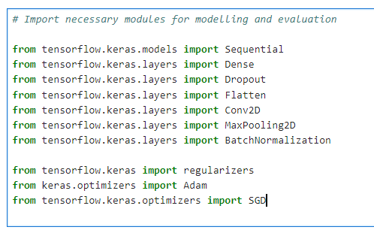
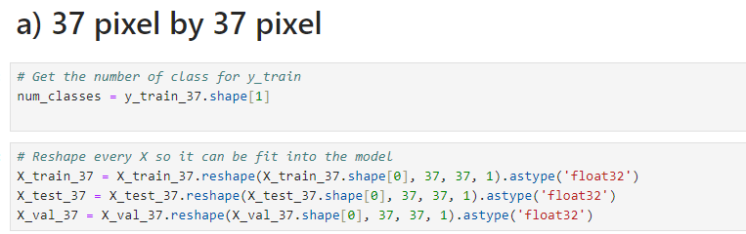
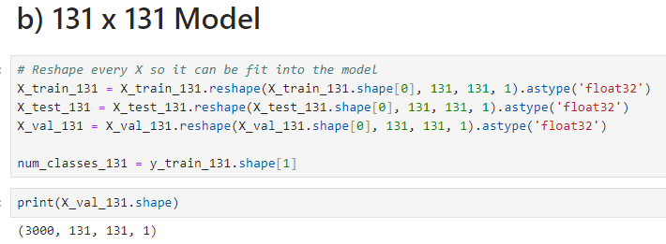
Modelling Preparation
Import necessary modules for modelling.
For 37 px by 37 px. Get the number of class for y_train_37 for modelling later. Reshape every X so it can be fit into the model later.
For 131 px by 131 px. Get the number of class for y_train_131 for modelling later. Reshape every X so it can be fit into the model later.

Slide 10
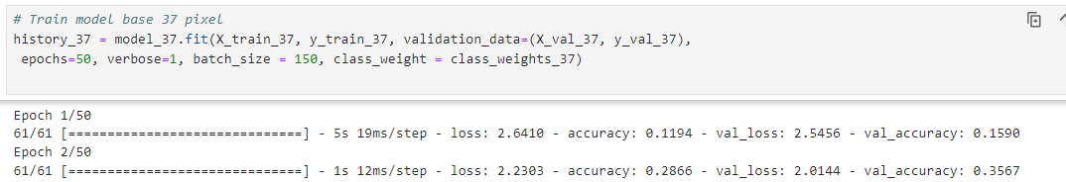
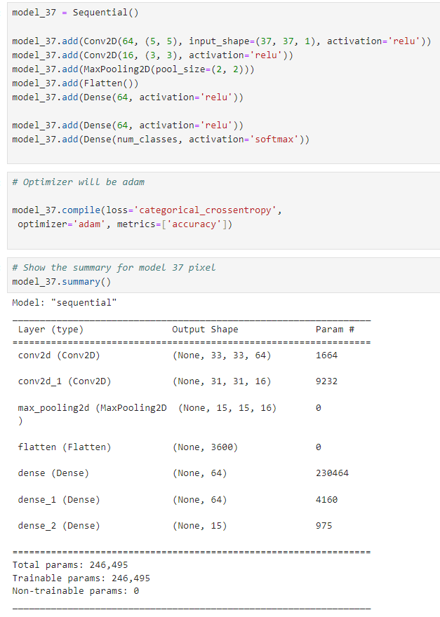
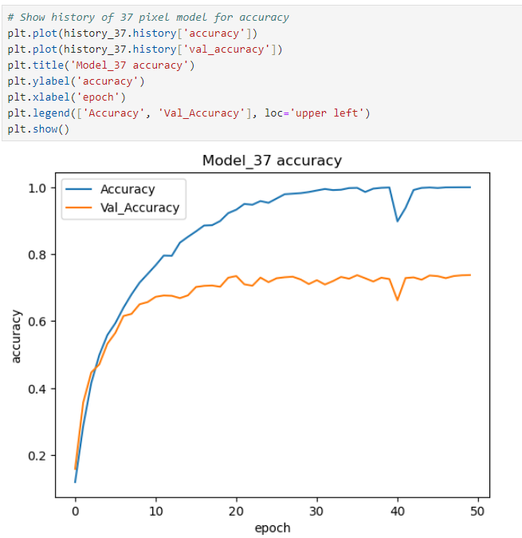
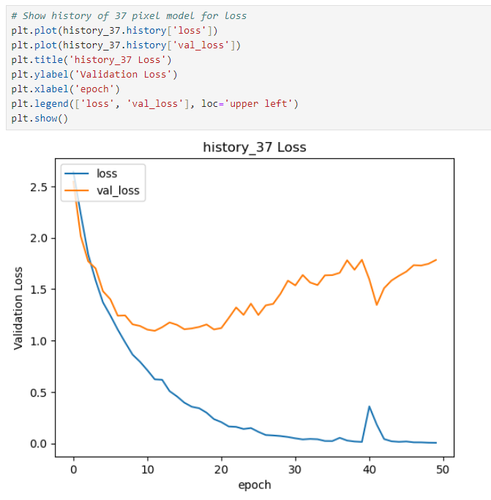
Base Model 37 by 37 pixel
Train base model for 37 by 37 pixel. Use class weight to rebalance.
Create a base model for 37 by 37 pixel to predict which image is in which class.
There seems to be an overfit for model 37 accuracy and loss. To prevent that and to increase accuracy and reduce lose, we will hypertune it by adding layers.

Slide 11
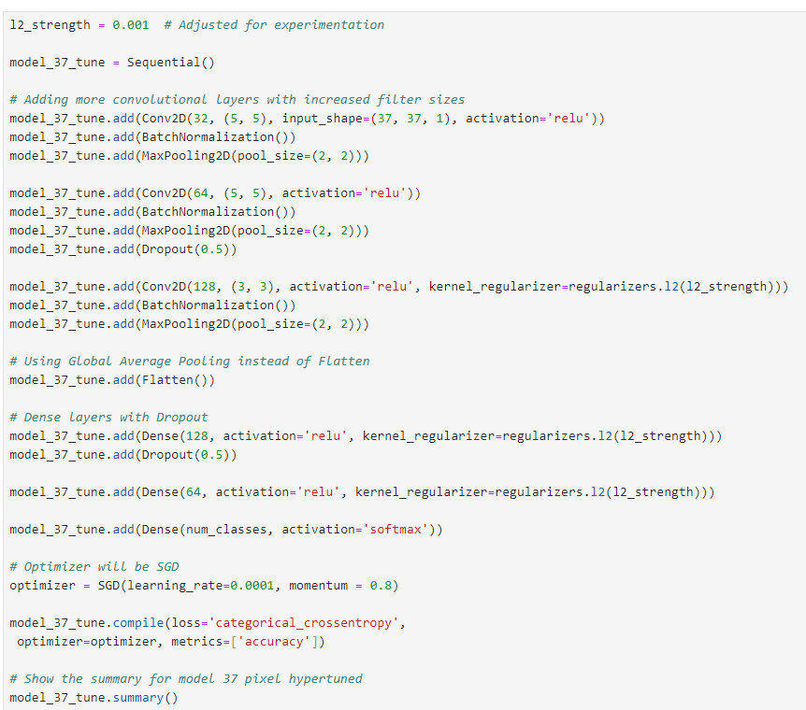
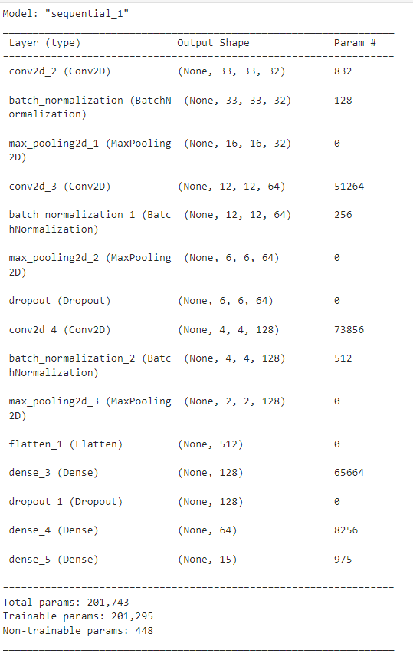
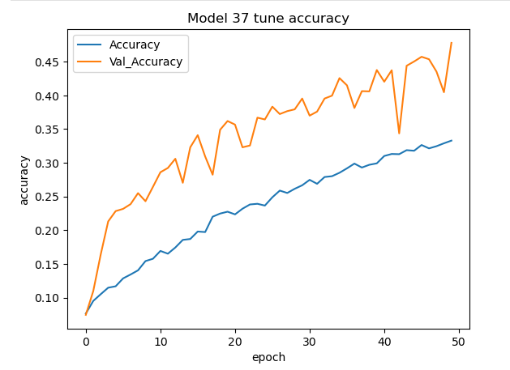
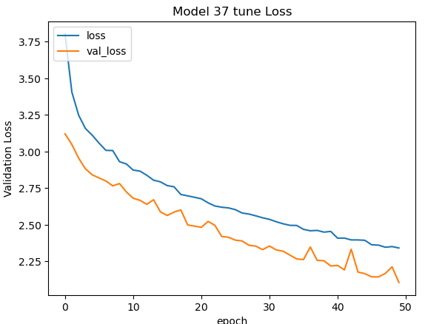
Hyperparameter tuning Model 37 by 37 pixel using SGD (Stochastic Gradient Descent)
We going to add more layers and use lasso regularization, dropout and maxpooling to control overfitting. BatchNormalization help normalize the input to increase training speed. Not only that, we use the optimizer SGD.
The overfitting seems to be way more controlled. However, the accuracy seems to be reducing a lot while the loss seems to be increase a lot too.

Slide 12

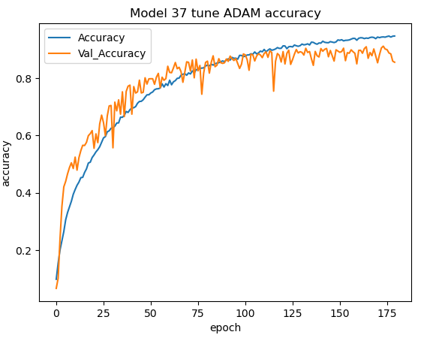
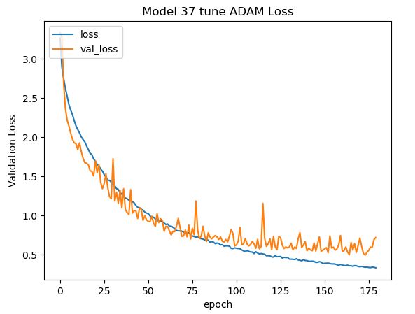
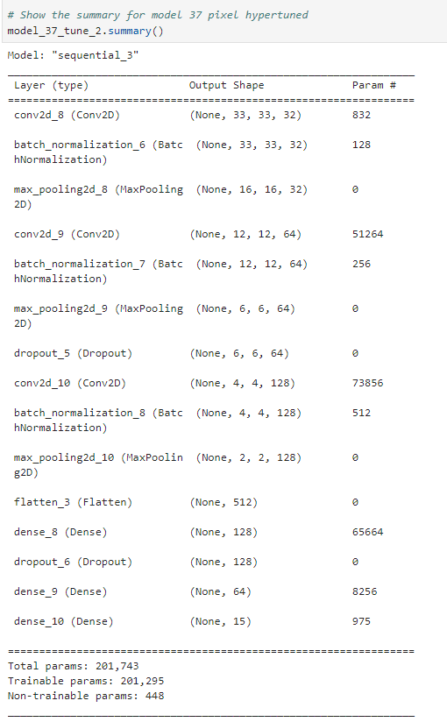
Hyperparameter tuning Model 37 by 37 pixel using ADAM
Model accuracy is way higher and low loss while also less overfit now too. Thus, this model will be the best model used for 37 by 37 pixel.
Model stays the same but optimizer change to Adam with learning rate of 0.0001 to control overfitting.

Slide 13
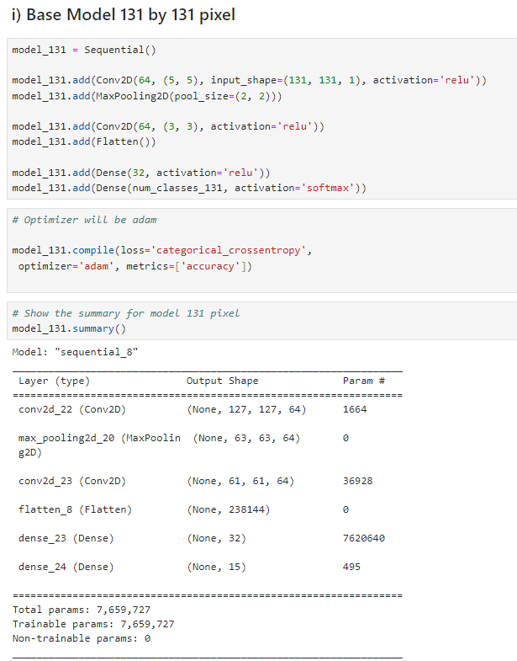
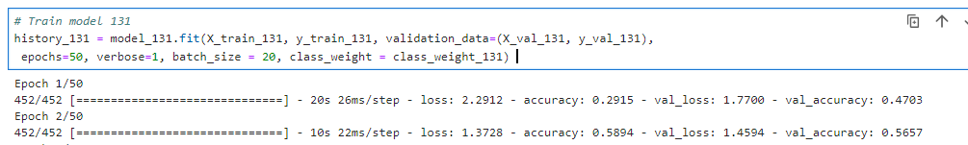
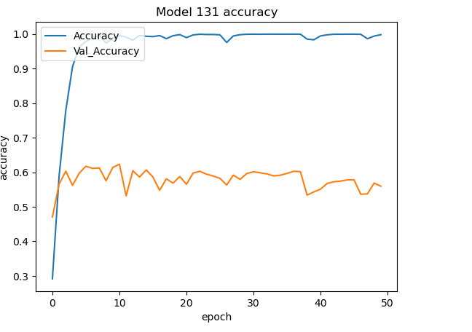
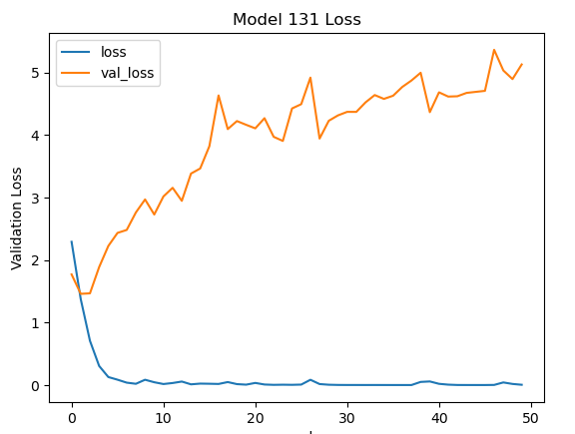
Base Model 131 by 131 pixel
Train base model for 131 by 131 pixel. Use class weight to rebalance.
There seems to be an overfit for model 37 accuracy and loss. To prevent that and to increase accuracy and reduce lose, we will hypertune it by adding layers.
Create a base model for 131 by 131 pixel to predict which image is in which class.

Slide 14
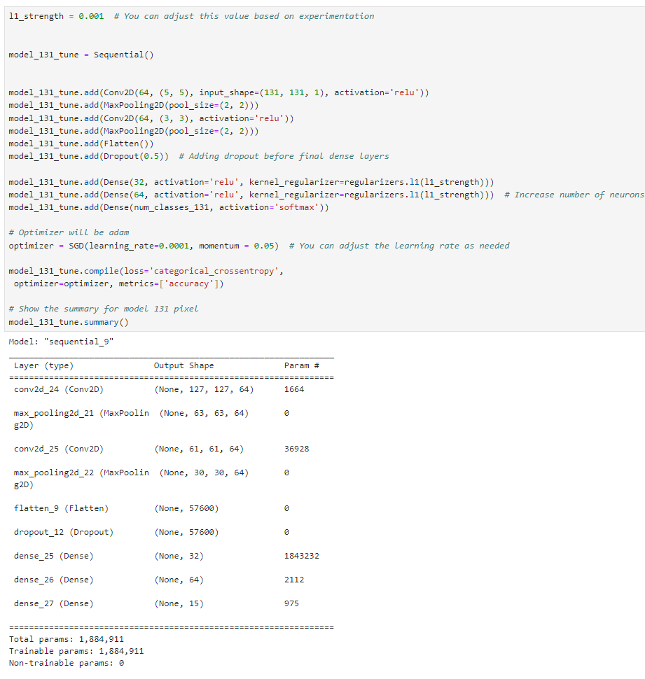
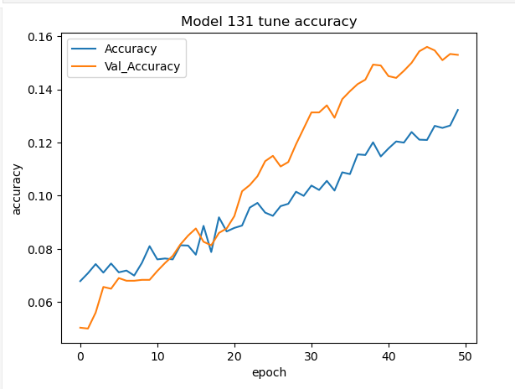
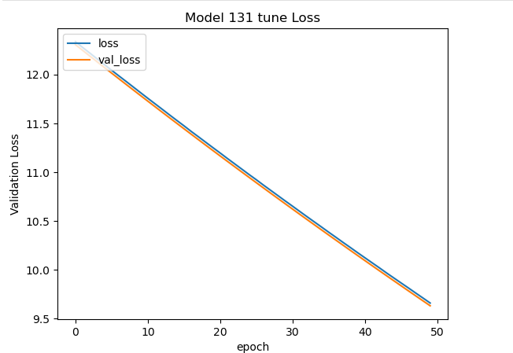
Hyperparameter tuning Model 131 by 131 pixel using SGD (Stochastic Gradient Descent)
Though there is no overfitting, the accuracy is too low while loss is too high. Thus, we should try change optimizer instead
We going to add more layers and use lasso regularization. Not only that, we use SGD.

Slide 15
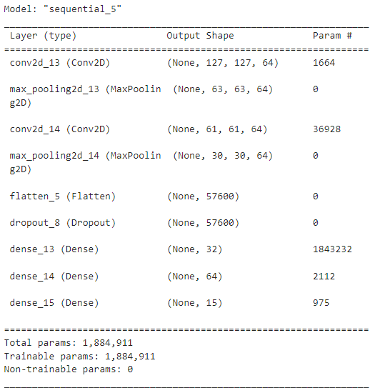
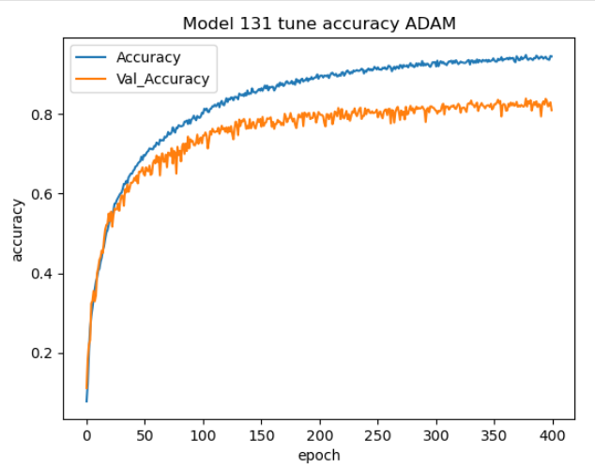
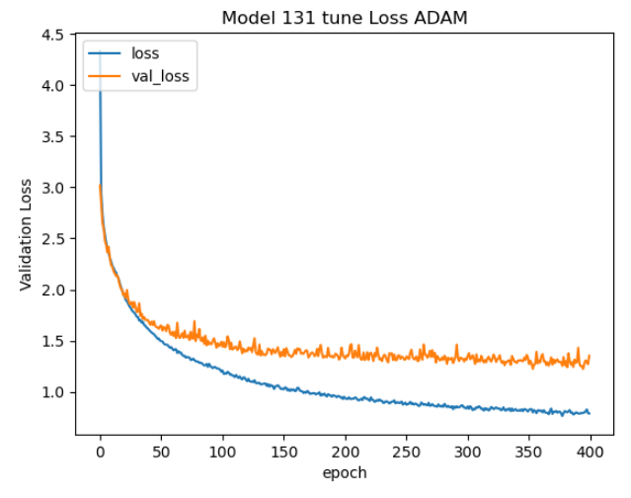
Hyperparameter tuning Model 131 by 131 pixel using ADAM
The val_accuracy is high and val_loss is low and it does not overfit as well. Thus, this model is best for 131 by 131 pixel.
Model stays the same but optimizer change to Adam with learning rate of 0.0001 to control overfitting.

Slide 16

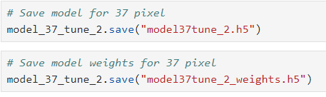
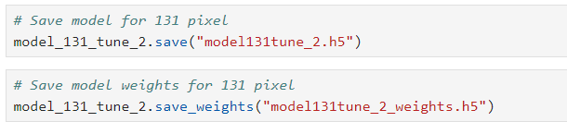
Model Evaluation
Import necessary modules for model evaluation
SAVE BEST MODELS FOR EACH 37 AND 131 PX
Save models for 37 pixel as model37tune_2.h5
Save model weights for 37 pixel as model37tune_2_weights.h5
Save models for 131 pixel as model131tune_2.h5
Save model weights for 131 pixel as model131tune_2_weights.h5

Slide 17
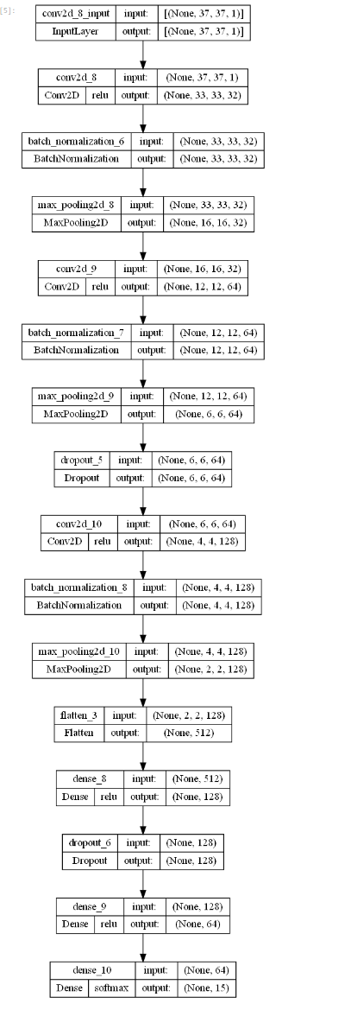
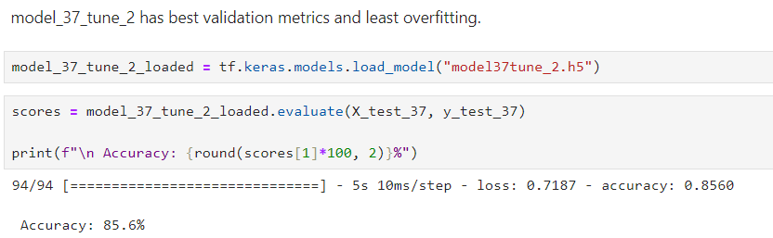
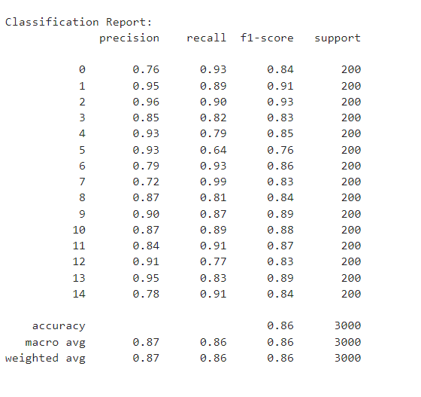
Model Evaluation for 37 pixel using best model
Visualise the model →
Accuracy for prediction for 37 pixel using best model is 85.6%
Classification report shows that the model predict Bitter_Gourd the best with 0.91 f1_score while it shows that the model predict Brinjal, Carrot, Pumpkin is the worst with 0.83 f1_score.

Slide 18
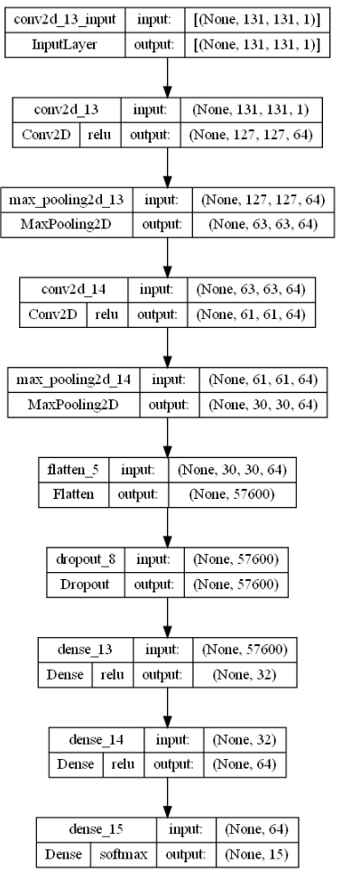
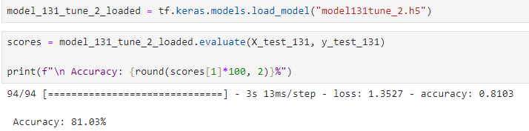

Model Evaluation for 131 pixel using best model
Visualise the model →
Accuracy for prediction for 131 pixel using best model is 81.03%
Classification report shows that the model predict Bitter_Gourd the best with 0.90 f1_score while it shows that the model predict Cauliflower with 0.72 f1_score.

